Slide 1

StableSwap
Simon Zhang Viseth Auk Toby Martin

Slide 2
COSTS ON DEXs
Orderbook replaced with automated market maker (AMM)
DEX keeps balance of liquidity between each trading pair
Price impact determined by the ‘buy’ amount and the effect it has on the liquidity of the token on the exchange.
Blockchain transaction fees – fee to use the network
Slippage cost - the percentage amount that the purchaser chooses to potentially pay over their asking price to ensure their trade goes through

Slide 3
Project Motivation
To create a platform to allow users to swap tokens similar to BeeSwap, UniSwap and Sushi Swap
Our goal is to provide a cheaper fee structure than these competitors
We hope that this will bring more people to our platform
Our Fee Structure
fees = (1-portion of total liquidity of output token) * 0.1%
if all pools have same liquidity, should expect average fee of 0.067%
Downside
We have less fees so liquidity providers may earn less interest compared to traditional LPs.
However, we hope that since we have lower fees, we will have a greater volume which will offset the lower interest.
Furthermore, we expect volume to move from traditional LPs over to our platform, thus lowering the interest rates of traditional LPs anyway

Slide 4
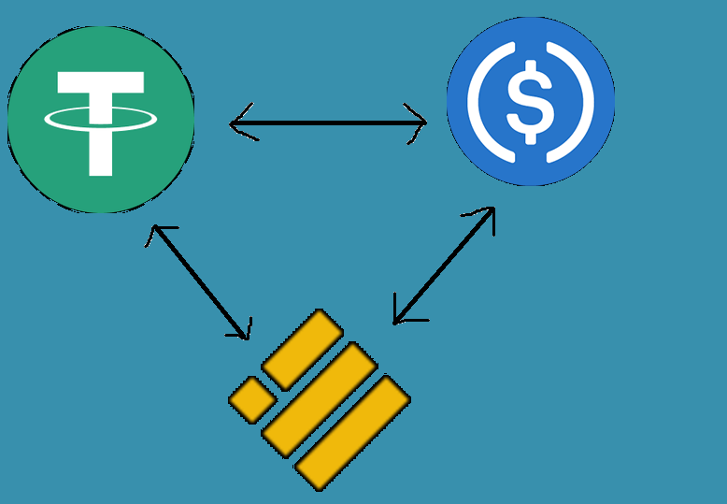
Stableswap
Multi Asset Liquidity Pool (MALP)
BUSD, USDT and USDC for prototype
Infinitely scalable pools
Reduce swap fees
Create interest for depositors
Give over-collateralized loans
Platform collects 10% of all fees
Stable Coin: cryptocurrency designed to be pegged to a specific value, in this case, 1 USD.

Slide 5
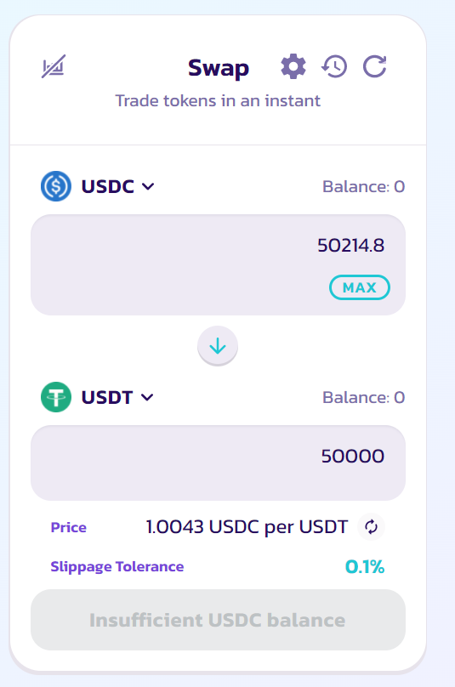
No more price impact fees
Stable coins are stable – price impact innately makes no sense
Creates loss for traders and investors
Income for arbitrage bots exploiting this inefficiency
Solution:
Scaling variable rate fee → upper bound for price impact
Will scale between near 0% to a maximum of 0.1%
$214.8 total fee
$125 gone to liquidity providers
$89.8 gone to price impact
At StableSwap, our max fee
for a $50k trade is $50.

Slide 6
Game Changer for capital efficiency
Double utilisation of funds
Additional income source for depositors leading to higher returns
Such as allowing other users to take out over-collateralized loans
Currently all done manually
Full release will include automated loan approval and liquidations
20% initial interest rate for stable coins
For reference, Binance charges 20.8% interest for margin trading stable coins
Anchor Protocol gives approximately 19% APY (daily compound) on Tera USD (UST)

Slide 7
Over-collateralised loans in practice
Below features are not yet implemented due to time constraints:
Auto-approval based on initial LTV ratio
Auto-liquidation based on current LTV ratio
Maximum loan utilization ratio
Variable interest rate depending on loans demand

Slide 8
The future of stableswap
Currently in the process of implementing this in a real world setting under a new name
In our team:
Discidium Pty Ltd as the project management team (co-founder)
Everlume as the marketing management team (core team)
Viseth (core team/advisor), Toby (core team/advisor) and Simon (founder)
Looking for:
Smart contract programmers (funded with initial capital injection)
VCs and angel investors (in 4-6 months)
Advisors in the field of DeFi/blockchain and marketing/influencers
Any other parties interested in our project!

